Slide 1

Back End Engineering (BEE-1)
MaidEase
Jatin Bhardwaj, 2310992109
Mehraab Singh, 2310992152
Navdeep Singh, 2310992162
Nitish Parkash, 2310992168
Class Group: G24
BEE-1 Faculty Name :
Dr. Kiran Deep Singh
Professor
Department of Computer Science and Engineering

Slide 2
About Hook & Opening
Creating a registration page involves both front – end and back – end development.
This will cover both the initial setup and the hook between the front end and back end.
Front End: The HTML form collects user input and uses JavaScript to send a POST request to the server when the form is submitted.
Back End: Creating Local Server listens for the POST requests at the /register endpoint, processes the form data, and sends back a response.

Slide 3
Key Concepts
HTML, CSS & JavaScript.
DOM Manipulation.
API Fetch.
Node.js
File System Operation.
JSON Format.
HTTP request and responses.

Slide 4
Key Features
Front End :
Created an HTML form with fields like name, email etc.
Use JavaScript to capture user input and send it to backend using a POST request.
Fetch the data from the backend and display it in a user- friendly format on the frontend.

Slide 5
Key Features
Back End :
Set up a simple Node.js server.
Create a JSON file to store user data
Handle POST request to save user data to the JSON file.
Handle GET requests to retrieve user data from the JSON file and send it back to the frontend.

Slide 6
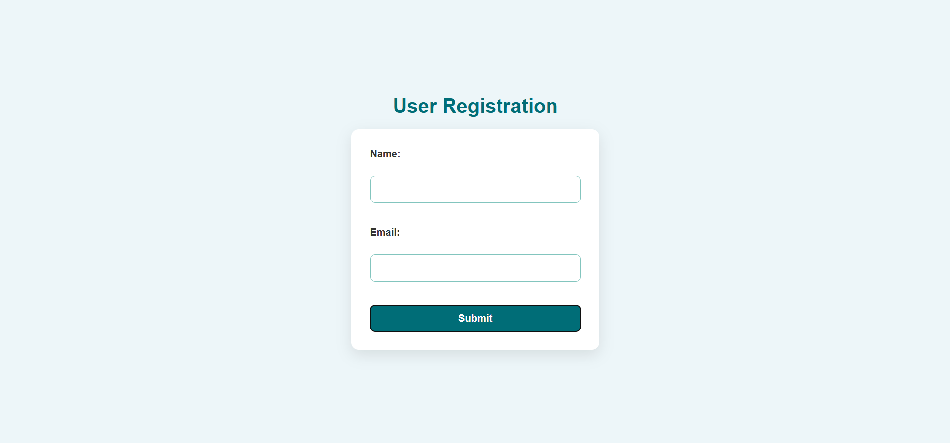
Screenshots

Slide 7
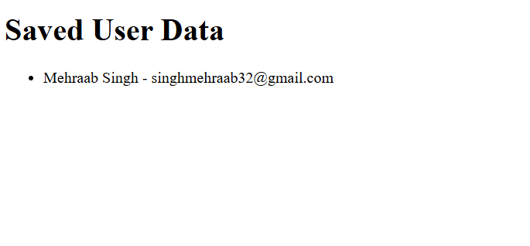
Screenshots
7

Slide 8
Thank You

